Slide 1
Module 2:
Cascading Style Sheets

Slide 2
Objectives
After completing this session, you will be able to:
  What is CSS
  Need of CSS in Web Application
  Types of CSS

Slide 3
Cascading Style Sheet [ CSS ]
What is CSS??
CSS stands for Cascading Style Sheets
Styles define how to display HTML elements
Styles were added to HTML 4.0 to solve a problem

Slide 4
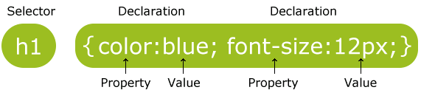
CSS Syntax
A CSS rule has two main parts: a selector, and one or more declarations:
The selector is normally the HTML element you want to style.
Each declaration consists of a property and a value.
The property is the style attribute you want to change. Each property has a value.
A CSS declaration always ends with a semicolon, and declaration groups are surrounded by curly brackets.

Slide 5
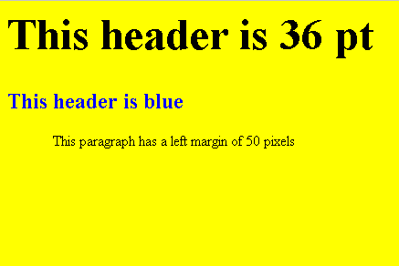
CSS Example :
<html>
<head>
<style type="text/css">
body {background-color:yellow;}
h1 {font-size:36pt;}
h2 {color:blue;}
p {margin-left:50px;}
</style>
</head>
<body>
<h1>This header is 36 pt</h1>
<h2>This header is blue</h2>
<p>This paragraph has a left margin of 50 pixels</p>
</body>
</html>

Slide 6
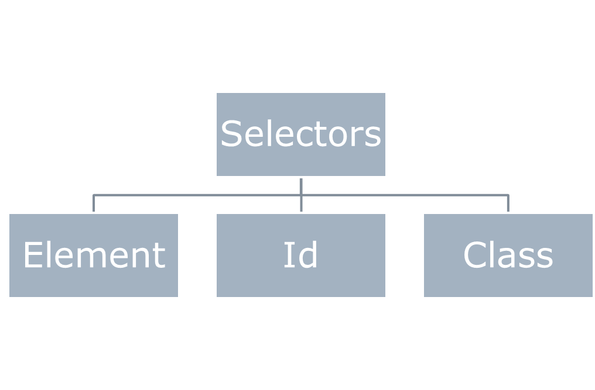
Selectors in CSS

Slide 7
Element Selector
The element selector selects elements based on the element name.
p {
text-align: center;
color: red;
}

Slide 8
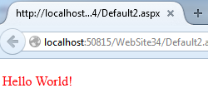
ID Selector
  The ID selector is used to specify a style for a single, unique element.
  The ID selector uses the id attribute of the HTML element, and is defined with a "#". For Example
<html>
<head>
<style type="text/css">
#para1
{
color:Red;
}
</style>
</head>
<body>
<p id="para1">Hello World!</p>
</body></html>

Slide 9
Class Selectors
The class selector is used to specify a style for a group of elements.
Unlike the id selector, the class selector is most often used on several elements.
This allows you to set a particular style for many HTML elements with the same class.
The class selector uses the HTML class attribute, and is defined with a ".“

Slide 10
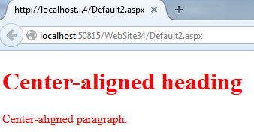
The Class Selectors (cont..)
Example:
<html>
<head>
<style type="text/css">
.colr
{
color:Red;
}
</style>
</head>
<body>
<h1 class=“colr">Center-aligned heading</h1>
<p class=“colr">Center-aligned paragraph.</p>
</body>
</html>

Slide 11
Ways to insert CSS in an HTML document
There are three ways of inserting a style sheet:
Types of CSS
External CSS
Internal CSS
Inline CSS

Slide 12
Inline CSS
An inline style loses many of the advantages of style sheets by mixing content with presentation. Use this method sparingly.
  To use inline styles you use the style attribute in the relevant tag.
  The style attribute can contain any CSS property.
  The example shows how to change the color and the left margin of a paragraph:
  <p style="color:sienna;margin-left:20px">This is a paragraph.</p>

Slide 13
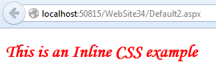
Example of Inline CSS
<html>
<head runat="server">
<title></title>
</head>
<body>
<form id="form1" runat="server">
<div>
<h2 style="color:Red; font-family:Monotype Corsiva;">
This is an Inline CSS example
</h2>
</div>
</form>
</body>
</html>

Slide 14
Internal CSS
An internal style sheet should be used when a single document
Internal style sheet has a unique style.
You define internal styles in the head section of an HTML page, by using the <style> tag, like this:
Example :
  <head>
  <style type="text/css">
  hr {color:sienna;}
  p {margin-left:20px;}
  body {background-image:url("images/back40.gif");}
  </style>
  </head>

Slide 15
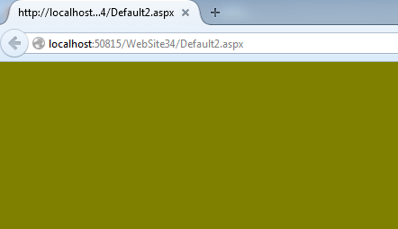
Example of Internal CSS
<html>
<head runat="server">
<title></title>
<style type="text/css">
.bdy
{
background-color:Olive;
}
</style>
</head>
<body class="bdy">
<form id="form1" runat="server">
</form>
</body>
</html>

Slide 16
External CSS
An external style sheet is ideal when the style is applied to many pages.
With an external style sheet, you can change the look of an entire Web site by changing one file.
Each page must link to the style sheet using the <link> tag. The <link> tag goes inside the head section.
Example :
<head>
<link rel="stylesheet" type="text/css" href="mystyle.css" />
</head>

Slide 17
Example of External CSS
Step1: Open Visual Studio 2010 IDE -> select New -> Website -> select ASP.NET Empty Web Site
Step2 : Now Click on Website tab -> select Add New Item Option>select web form and rename it as extrenalcssex.aspx
Step 3: Now click on Website tab -> select Add New Item Option>select Style Sheet and rename it as myexternal.css
Step 4: In the external css file add the code:
.hd
{
color:Green;
font-family:Monotype Corsiva;
}
Step 5: Save the css file.

Slide 18
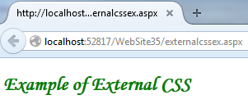
Example of External CSS (cont…)
Step 6: Now select myexternal.css present in Solution Explorer window and drag and drop it under the head section in externalcssex.aspx web page.
Step 7: Now write the following code to use the external css styles in your web form:
<html >
<head runat="server">
<title></title>
<link href="myexternal.css" rel="stylesheet" type="text/css" />
</head>
<body>
<form id="form1" runat="server">
<div>
<h2 class="hd">Example of External CSS</h2>
</div>
</form></body></html>

Slide 19
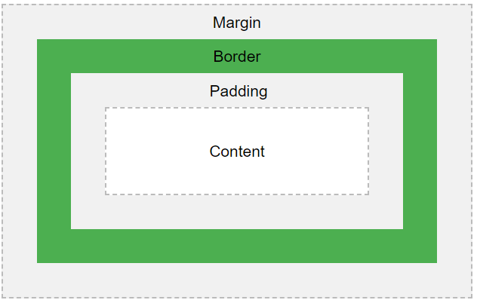
Box Model
All HTML elements can be considered as boxes.
In CSS, the term "box model" is used when talking about design and layout.
The CSS box model is essentially a box that wraps around every HTML element.
It consists of: margins, borders, padding, and the actual content. The image below illustrates the box model:

Slide 20
Explanation of the different parts:
Content - The content of the box, where text and images appear
Padding - Clears an area around the content. The padding is transparent
Border - A border that goes around the padding and content
Margin - Clears an area outside the border. The margin is transparent
The box model allows us to add a border around elements, and to define space between elements.
div {
width: 300px;
border: 15px solid green;
padding: 50px;
margin: 20px;
}

Slide 21
Thank You…!

